Slide 1
Debugging Minesweeper
Andres, Alex, Jonathan

Slide 2
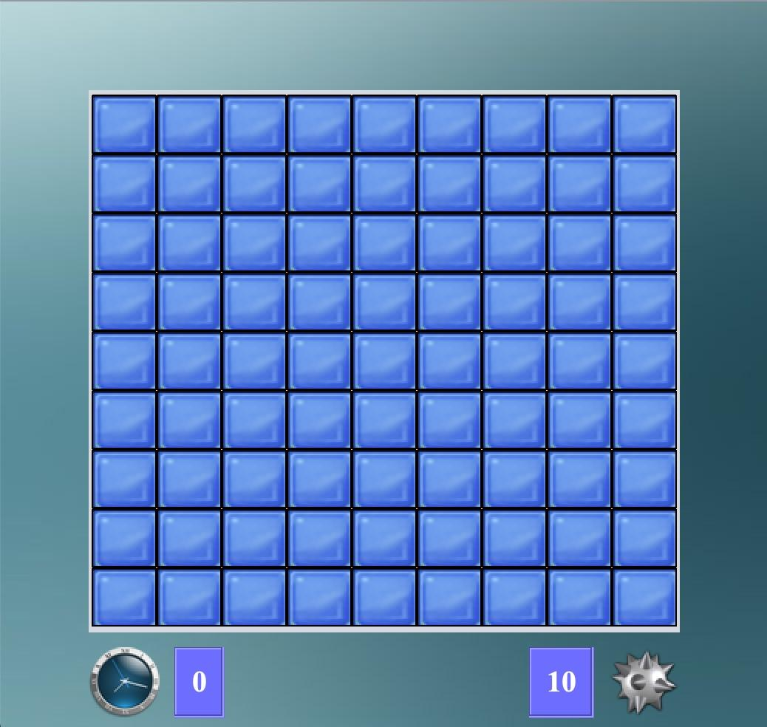
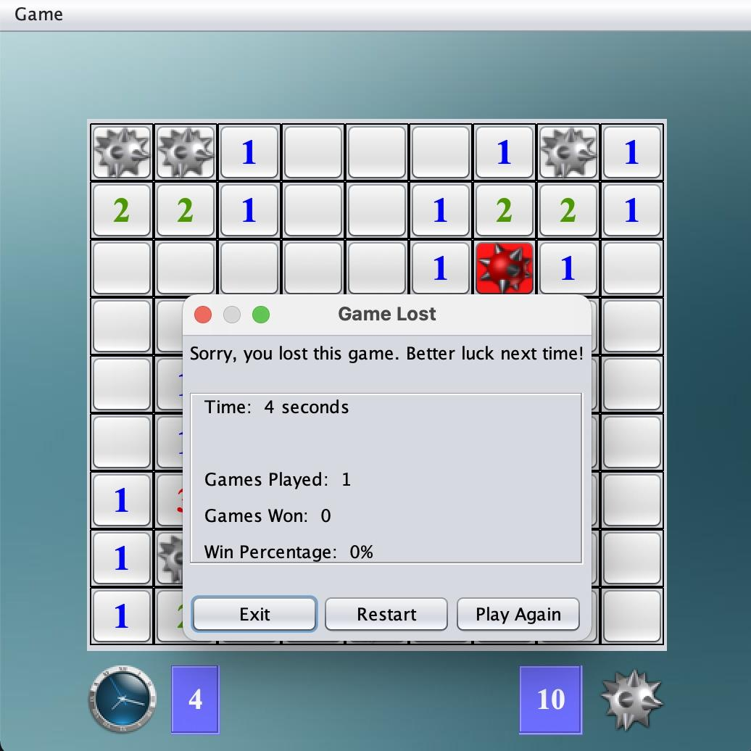
The Game
Objective: Identify all mines on the board.
Gameplay: Clicking on a square reveals the number of adjacent mines. However, you can flag squares as mines by right clicking.
Rules: If you click on a mine, you lose! You also can only flag a certain number of mines.
Notes:
I think we all know minesweeper, but just to quickly explain: the objective of the game is to identify all the mines on a board of tiles. Clicking on a square will reveal the number of adjacent tiles which contain mines. You keep clicking on tiles until you either identify all the mines and win, or you find a bomb and lose.

Slide 3

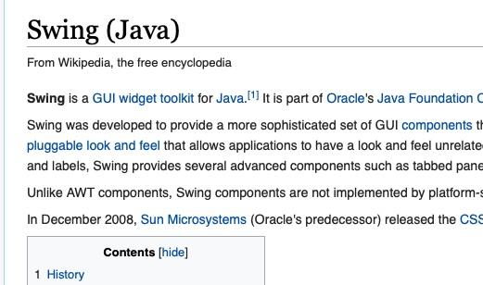
The Code
Language: Java (JDK 8)
Type of App: Desktop application (executable JAR file)
Users: Casual video game players, office workers, anyone with a bit of time to kill
Notes:
The software is coded entirely in Java, using JavaFX for the GUI. It is a desktop application formatted as an executable JAR file. And it has a fairly broad potential user base, so anyone from casual video game players to office workers, to anyone with a bit of time to kill is the target audience. But in reality this code hasn’t actually seen much action. Now jonathan will start us off by discussing GUI testing.

Slide 4
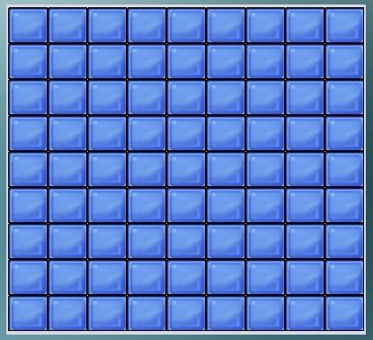



GUI Testing
Using JAssert for testing

Slide 5
Integration Testing
Using JUnit
Score
Game
UI
Board
Notes:
We can see here a partial UML diagram that describes the relationships between Game, Score, Board, and UI. We can see that Game contains these classes as member fields, so we conducted integration testing primarily on the relationships in the Game class. The coverage criteria we focused on was: if a method in Game calls a method in another class, that call should occur in a test. We did state-based testing

Slide 6
Unit Testing
Currently Covered:
Board.java : 17 methods
Cell.java: 7 methods
Game.java: 15 methods
UI.java - 23 methods
Score.java - none
Goal: Branch Coverage & Loop Boundary Adequacy (harder to achieve)

Slide 7
Conclusion
Faults Found:
GUI allows user to right click more than the number of mines allowed meaning all cells can be flagged and number of mines is negative
All double for loops that traverse the grid are reverse indexed, as a result, not allowing for anything but a square play grid
Intense coupling to hard-coded values in UI prevent anything smaller than a 2x2 board (reasonable)
Current Streak is decremented on loss
Win streak and Loss streak are not reset when the other event occurs
Few checks for malformed input
Lessons Learned:
Importance of documentation
Importance of coverage criteria
High coupling makes state-based testing more difficult
Shortcuts in code makes it harder to test, which can lead to more bugs
Importance of helper functions that take input and produce output

Slide 8
Thank You

